Slide 1

END OF STUDIES PROJECT QuantLib 1.3
Presented by: | Ahmed Ayadi Nathan D.Kruck Nolan Potier | Supervised by: | Mme. Anne Marie HUGUES & Mr. Luigi BALLABIO

Slide 2
Plan
II-Library components
III-Barrier Options
IV-Work flow
I-QuantLib Presentation

Slide 3
I-QuantLib 1.3
Quants and Developers
C++ , 2000
Ferdinando Ametrano and Luigi Ballabio
Open Source Initiative Certified
Boost library
Notes:
-The initial QuantLib release was 0.1.1 in Nov 2000
-Is primarily the work of Ferdinando Ametrano and Luigi Ballabio
-Boost has been a QuantLib requirement since July 2004

Slide 4
II-Library components
Macros <ql/
qldefines.hpp>
Design patterns <ql/patterns>
Utilities <ql/utilities>
Numeric types <ql/types.hpp>
Currencies and FX rates <ql/currencies>
Date and time calculations <ql/time>
Math tools <ql/math>
Stochastic <ql/processes>
Cashflows <ql/cashflows>
Term structures <ql/
termstructures>
Indexes <ql/indexes>
Quotes <ql/quotes>
Financial instruments <ql/instruments>
Models <ql/models>
Methods <ql/methods>
Pricing engines <ql/
pricingengines>
Notes:
-Instruments allow to represent a financial instrument like a Vanilla Option with its different parameters (volatility, strike, maturity …)
-Pricing Engine allow to calculate the instrument values.

Slide 5
II-Library components

Slide 6
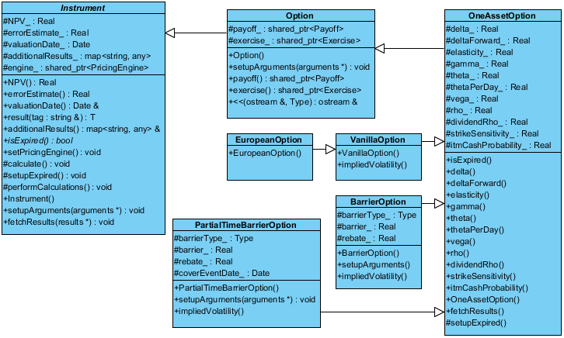
III-Barrier Options

Slide 7
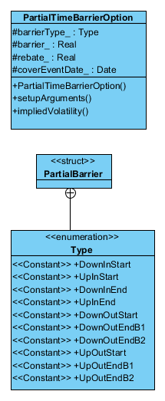
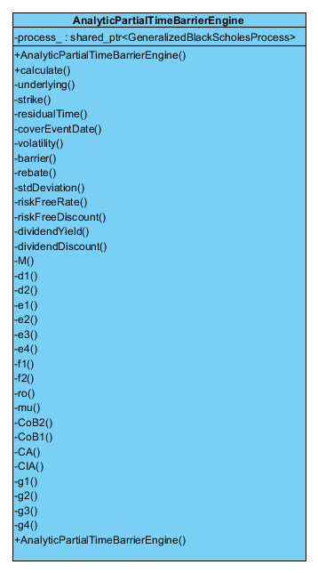
III-Barrier Options

Slide 8
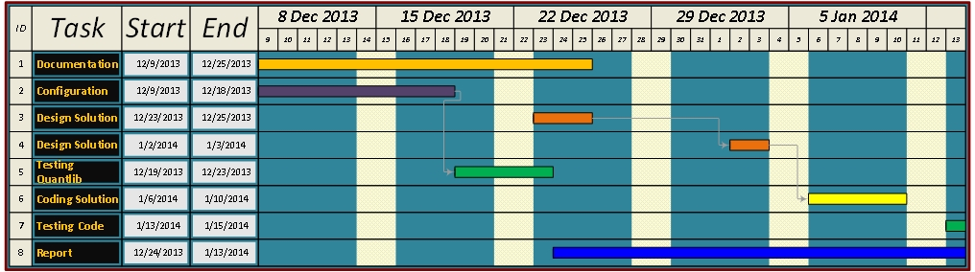
IV-Work flow

Slide 9
Thank You ☺
Questions

